Slide 1
ENTREPRENEURSHIP FINAL REPORT
CRUDO CAFÉ
By Vivian Junita
STUDY PROGRAM OF CULINARY ART
OTTIMMO INTERNATIONAL MASTERGOURMET ACADEMY
SURABAYA
2017

Slide 2

Notes:
Greetings :
Good Morning / Afternoon – Introduce yourself – Then Explain About Crudo (Meaning, Concept, Kind of Food it serve)
‘-

Slide 3

“Healthy”
Each person has different interpretation of healthy.
Healthy in Crudo is fluent to healthy for fitness.
“Fitness Diet” -> Reduced Sugar, Salt & Fat.

Slide 4
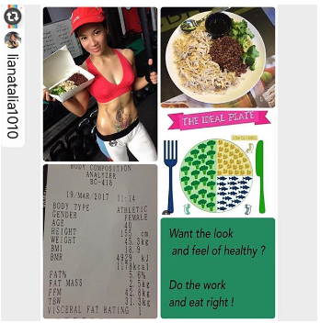
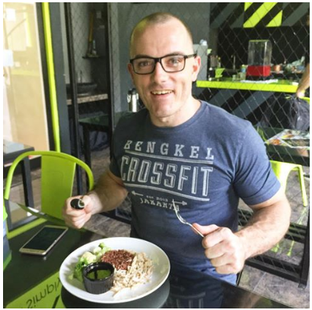
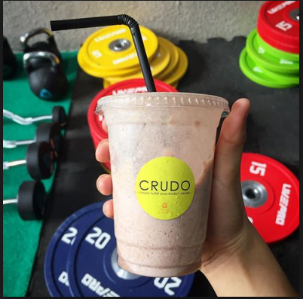
Our Food Specialized For “Fitness Person”

Slide 5
Pre-workout & Post-workout
Pre-workout
Post-workout
Meal that taken 30m-60m (light), 2 hrs (heavy) before workout time.
Need the right fuel to optimized workout’s performance.
Meal that taken 30m-60m after workout time.
After exercising, Enzyme increased, efficient in storing Glucose as energy, muscle building & recovery for fatigue muscle.

Slide 6
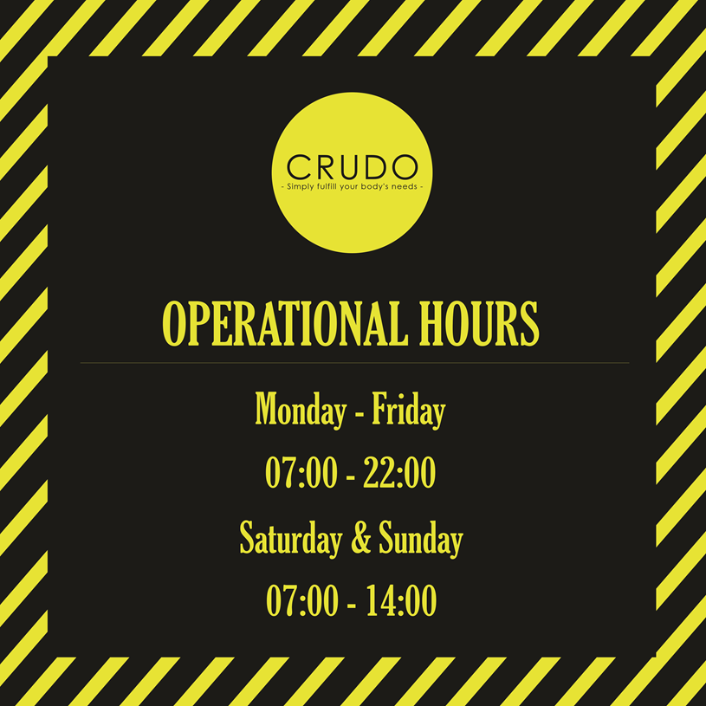

Slide 7
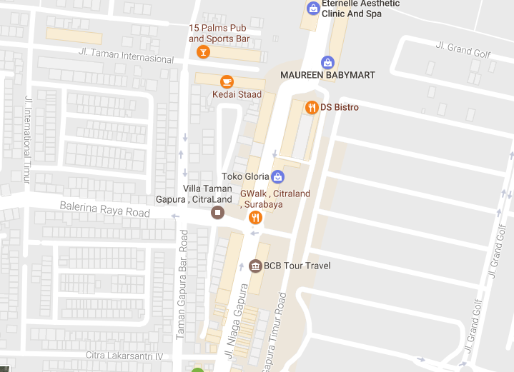
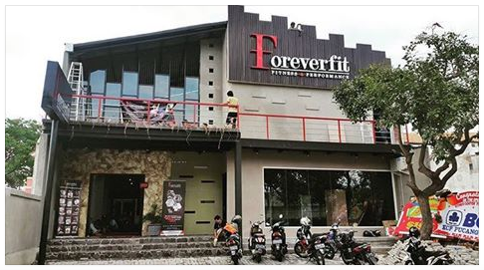
Strategic Marketing – Place !
- Strategic Location -
Crudo Café at ForeverFit Gym
Our store :
Jl. Taman Gapura BB-6, Gwalk,
Citraland – West Surabaya.
Notes:
Explain about location , How strategic the location!

Slide 8
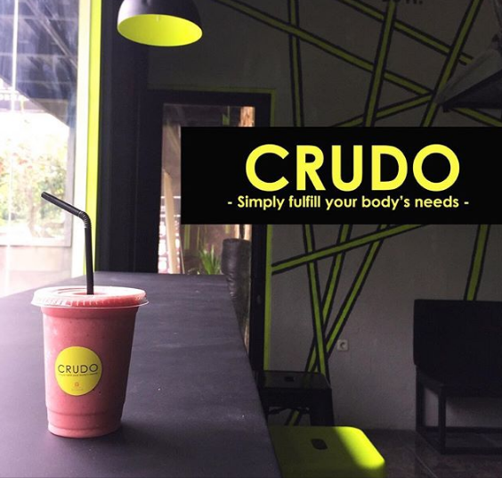
PRODUCT ASPECT
Product Description
Materials and Equipments
Production Method

Slide 9
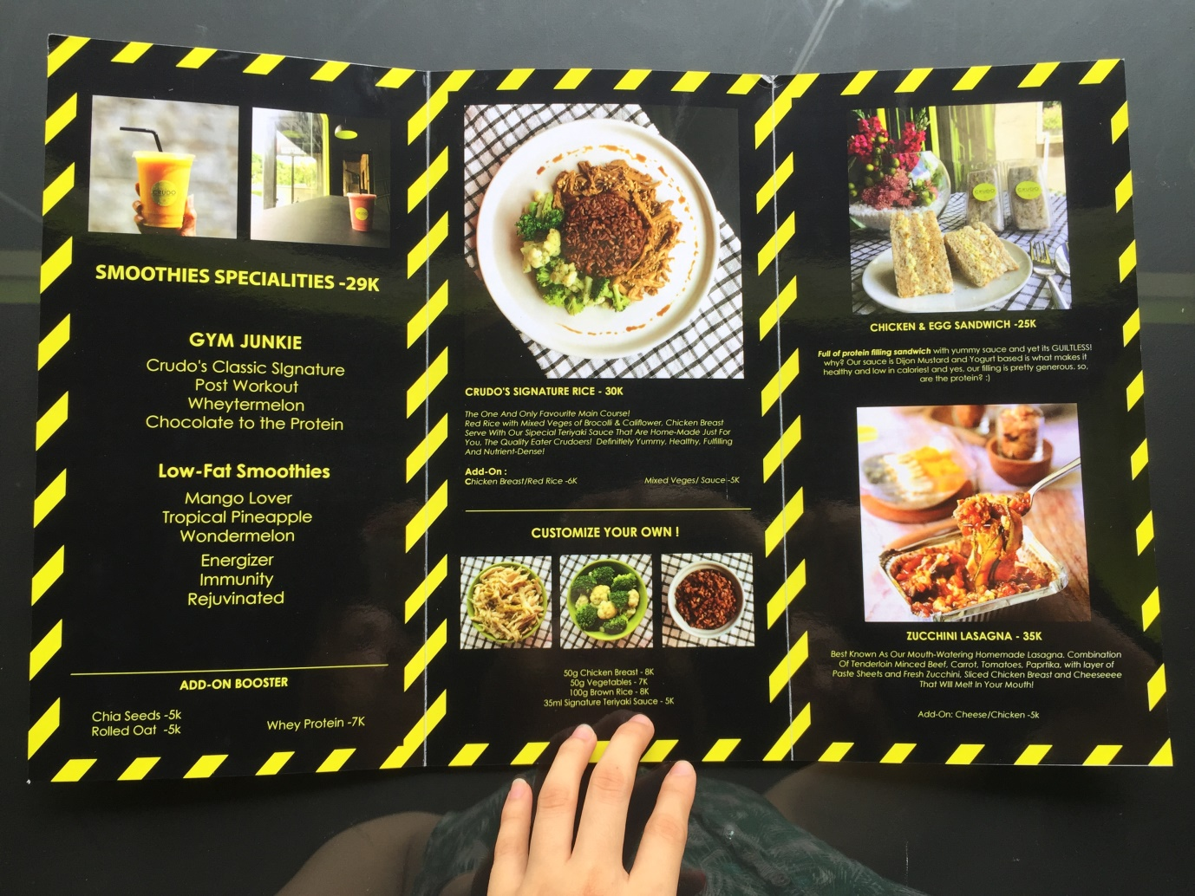
Crudo Café MENU -

Slide 10
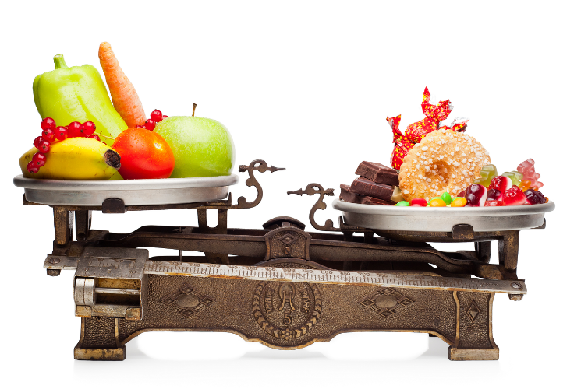
Healthy Vs Regular
Food comparison ?!?
Notes:
HEALTHY FOOD
REGULAR FOOD
Ideal composition of Carbohydrates, Protein,Fat and Fibre.
Mostly unideal composition portion for Carbohydrates, Protein, Fat and Fibre. Most likely Carbohydrates and Fat dominant.
Contain less Soduim, Sugar and Fat.
High in Sodium, Sugar and Fat.
Quality eater. Consume what is good for the body.
Quantity prefered. As long as it taste good and fulfilling.
Result:
Nourishing the body. Healthier body, happier mood. Ideal body weight.
Result:
Nourish the body but imbalance nutrition.
If the person is inactive person, will risk in weight gain or weaker antibody.

Slide 11
HEALTHY FOOD | REGULAR FOOD
Ideal composition of Carbohydrates, Protein,Fat and Fibre. | Mostly unideal composition portion for Carbohydrates, Protein, Fat and Fibre. Most likely Carbohydrates and Fat dominant.
Contain less Soduim, Sugar and Fat. | High in Sodium, Sugar and Fat.
Quality eater. Consume what is good for the body. | Quantity prefered. As long as it taste good and fulfilling.
Result: Nourishing the body. Healthier body, happier mood. Ideal body weight. | Result: Nourish the body but imbalance nutrition. If the person is inactive person, will risk in weight gain or weaker antibody.

Slide 12
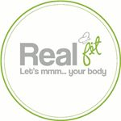

 |  | Figure 14 – Logo, Crudo
Appx. IDR 50,000 per meal | Appx. IDR 100,000 per meal | Appx. IDR 35,000 – IDR 50,000 per meal
Portion just right or for some might not enough. | Generous portion. | Regular Portion.
Delivery Only | Dine In or Delivery | Dine In or Delivery
Home Production | Located at: San Diego Main Street 109 East Surabaya | Located at: Foreverfit gym centre Taman Gapura BB 6 Citraland, West Surabaya
Variety Menus only for Diet Mayo & Healthy Catering | Variety Menus & Customization for Fat Loss, Diabetic, Weight Loss. | Varieties Menus & Snacks, customized for Healthy meal. Soon: Fat Loss, Weight Loss meal programs.
Medium class segmentation | Medium to high class segmentation | Medium class segmentation.

Slide 13
Strategic Marketing – Price
IDR-50K
IDR-100K
IDR-35K
Notes:
Explain about price vs taste & portion!

Slide 14
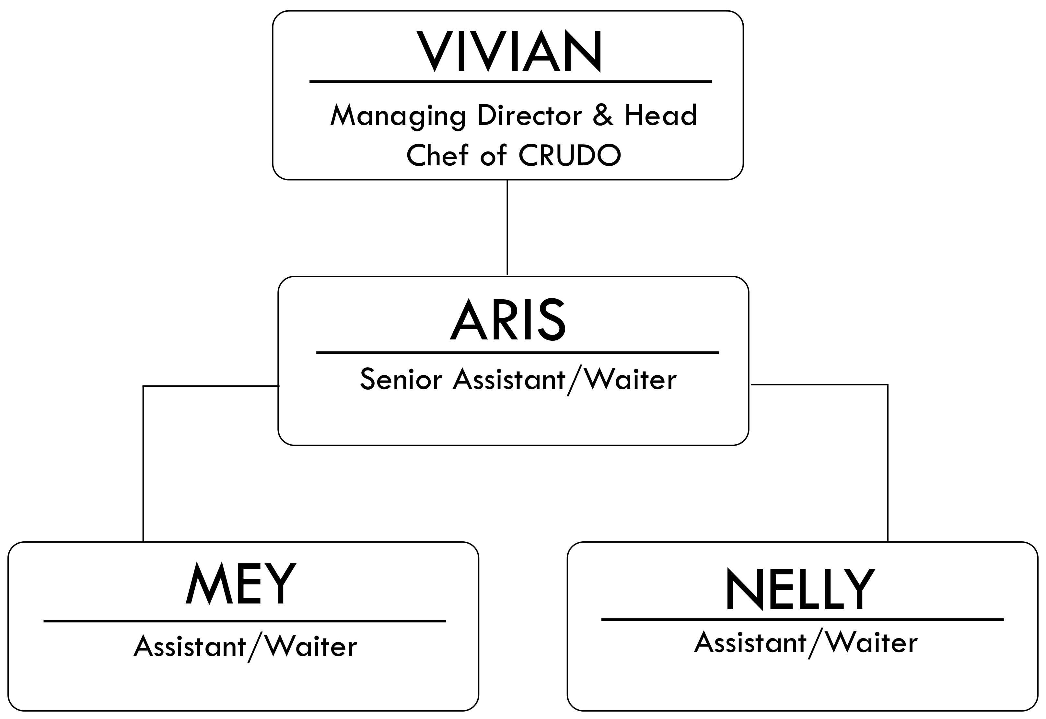

Strategic Marketing – People ?
_ Our Human Resources _

Slide 15

Strategic Marketing – Process ?
Crudo Cafe
Buy online (Gojek) or?
Come to our store at Gwalk!
Choose your Favourite Menu!
Or choose from our display in chiller!
Make a payment and Enjoy your food

Slide 16
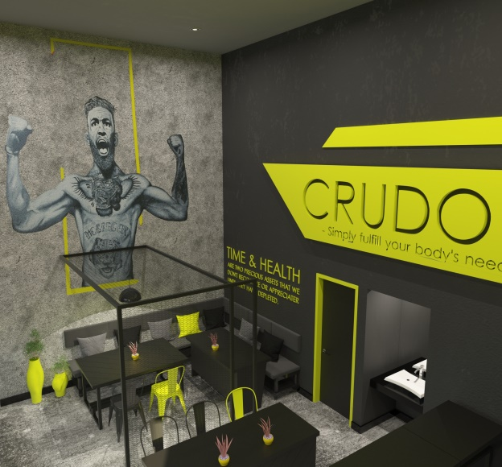
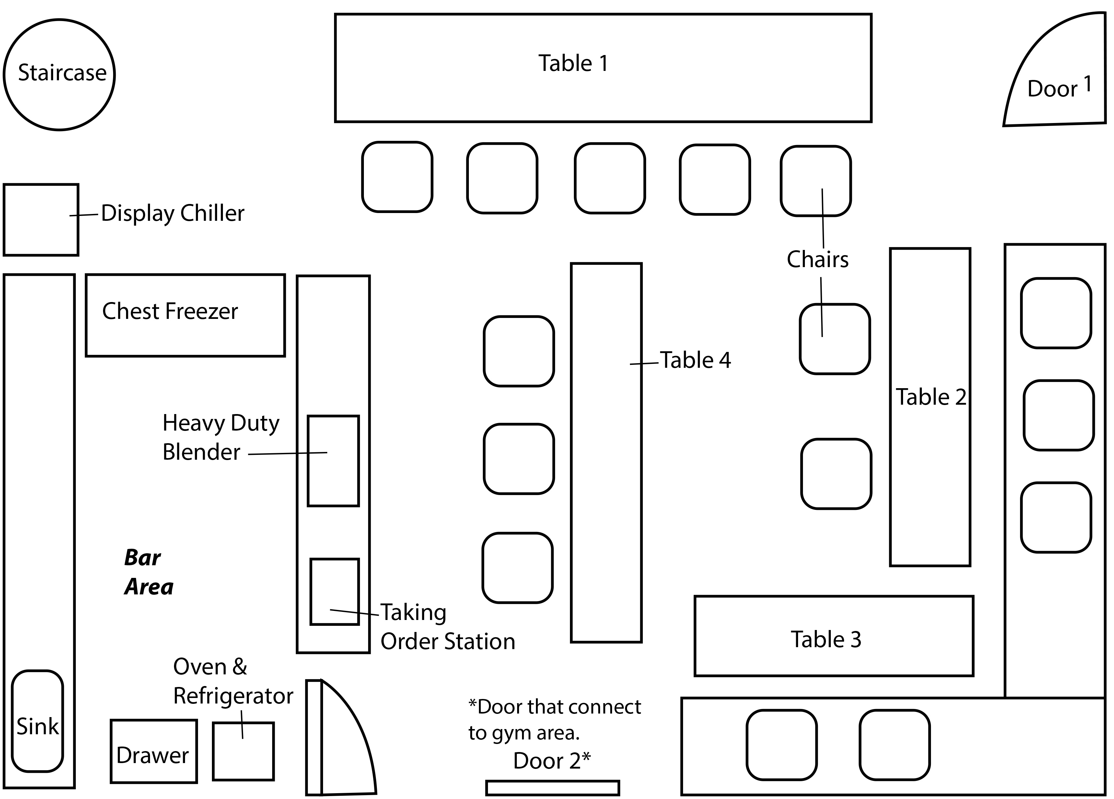
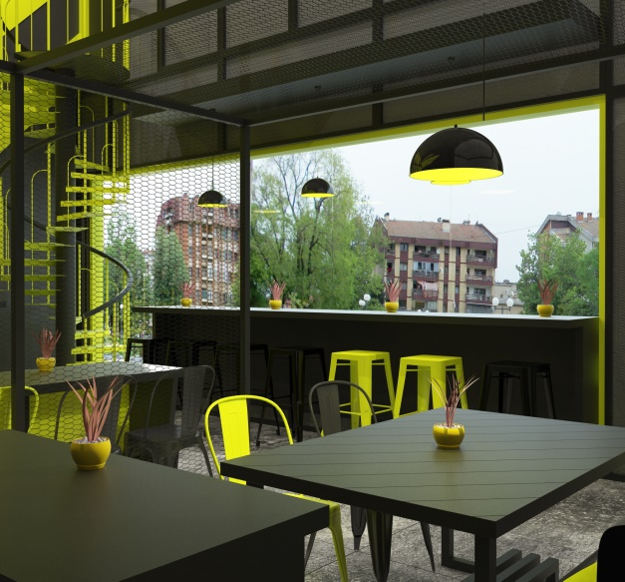
Physical Environment-
Crudo Café Layout

Slide 17
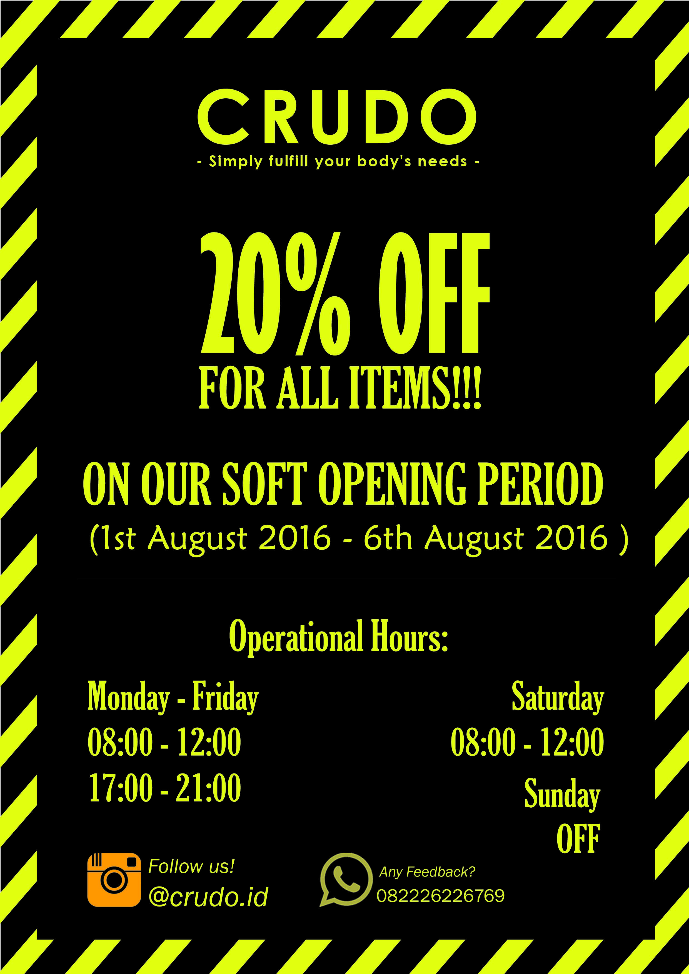
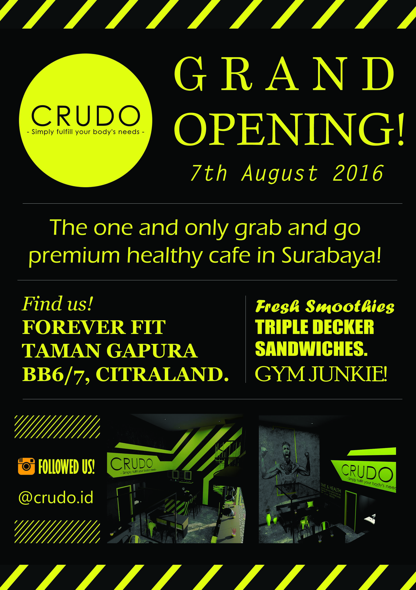
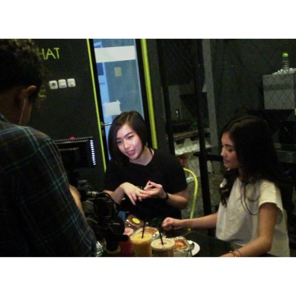
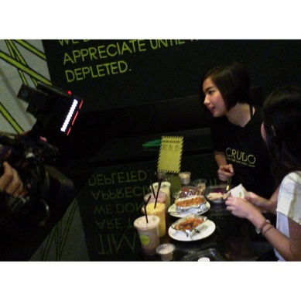
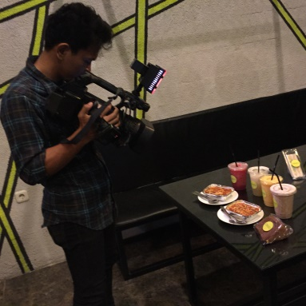

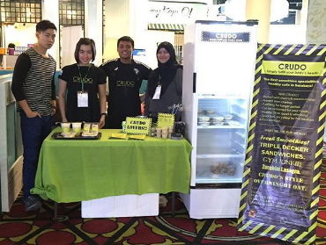
PROMOTIONS
Soft Opening & Grand Opening Promotion! 20% OFF for all item.
Crudo Inteview on SBO TV
Bazaar & Events!

Slide 18
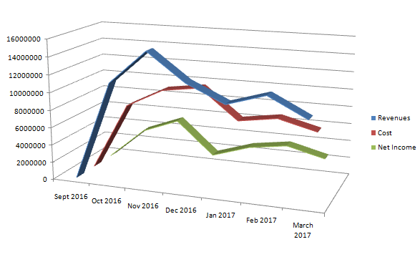

Financial Aspects
In IDR (Indonesian Rupiahs)

Slide 19


