Slide 1
COMPANY PROFILE TAJO
VIELLA CHIAROUVEN

Slide 2
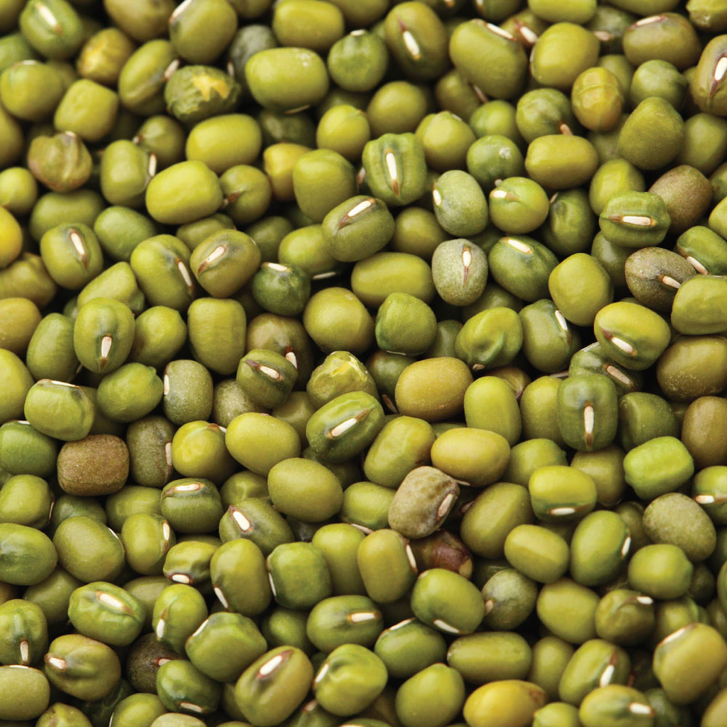
TAJO
FERMENTED MUNG BEANS

Slide 3
01
02
Table of
Contents
03
04
OUR HISTORY
PRODUCT, VISION & MISION
FOUNDER
CONTACT

Slide 4
01
OUR HISTORY

Slide 5
Tajo are made by fermenting mungbeans. People in Indonesia are familiar with mung beans because mung beans are tasty, and comfort food of Indonesian people. They are easy to buy, simple to eat, can be apply to other recipe.

Slide 6
02
PRODUCT, VISION & MISION

Slide 7
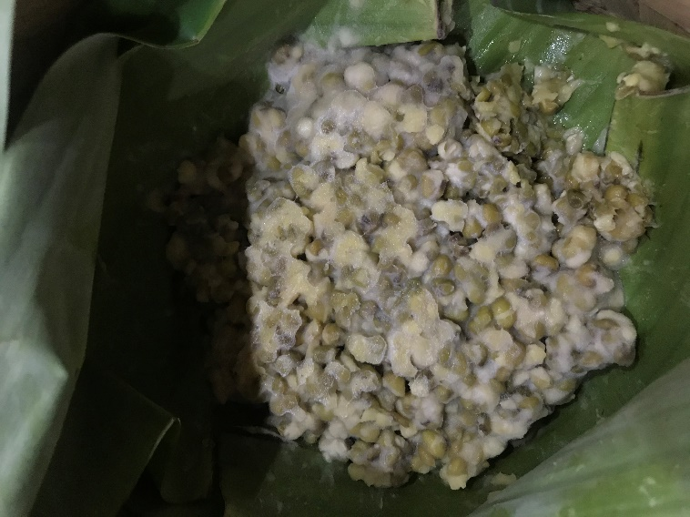
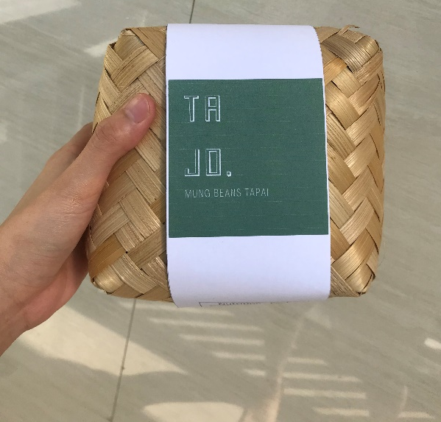
PRODUCT
Composition:
Mung beans, sugar, tapai yeast.
Health benefit :
Improve the nutritional value of mung bean. (increase protein, potassium and calcium content,
b. Source of probiotic,
c. Detoxification of antinutritional factors .

Slide 8
Rp 25.000
PRICE

Slide 9
NUTRITION FACTS
NUTRITION FACTS
Serving size 100 gr
Serving per Container 1 serving
Amount per serving
Calories 359.184 kkal
Total Fat 1.5 gr
Carbohydrates 63.521 gr
Protein 22.9 gr
The % Daily Value tells you how much nutrient in a serving of food conributed to a daily diet. 2000 calories a day is used for general nutrition advice.

Slide 10
VISION
VISION & MISION
MISION
Our vision is to build on our success and high standart. We also plan to extend the sales up until worldwide
Our mission is to deliver the best quality products to consumer who have relied on us.

Slide 11
FOUNDER
VIELLA CHIAROUVEN
OTTIMMO INTERNATIONAL STUDENT

Slide 12
CONTACT
LINE : TAJO.ID
INSTAGRAM : @TAJO.ID
CUSTOMER SERVICE : 0812233445

