Slide 1
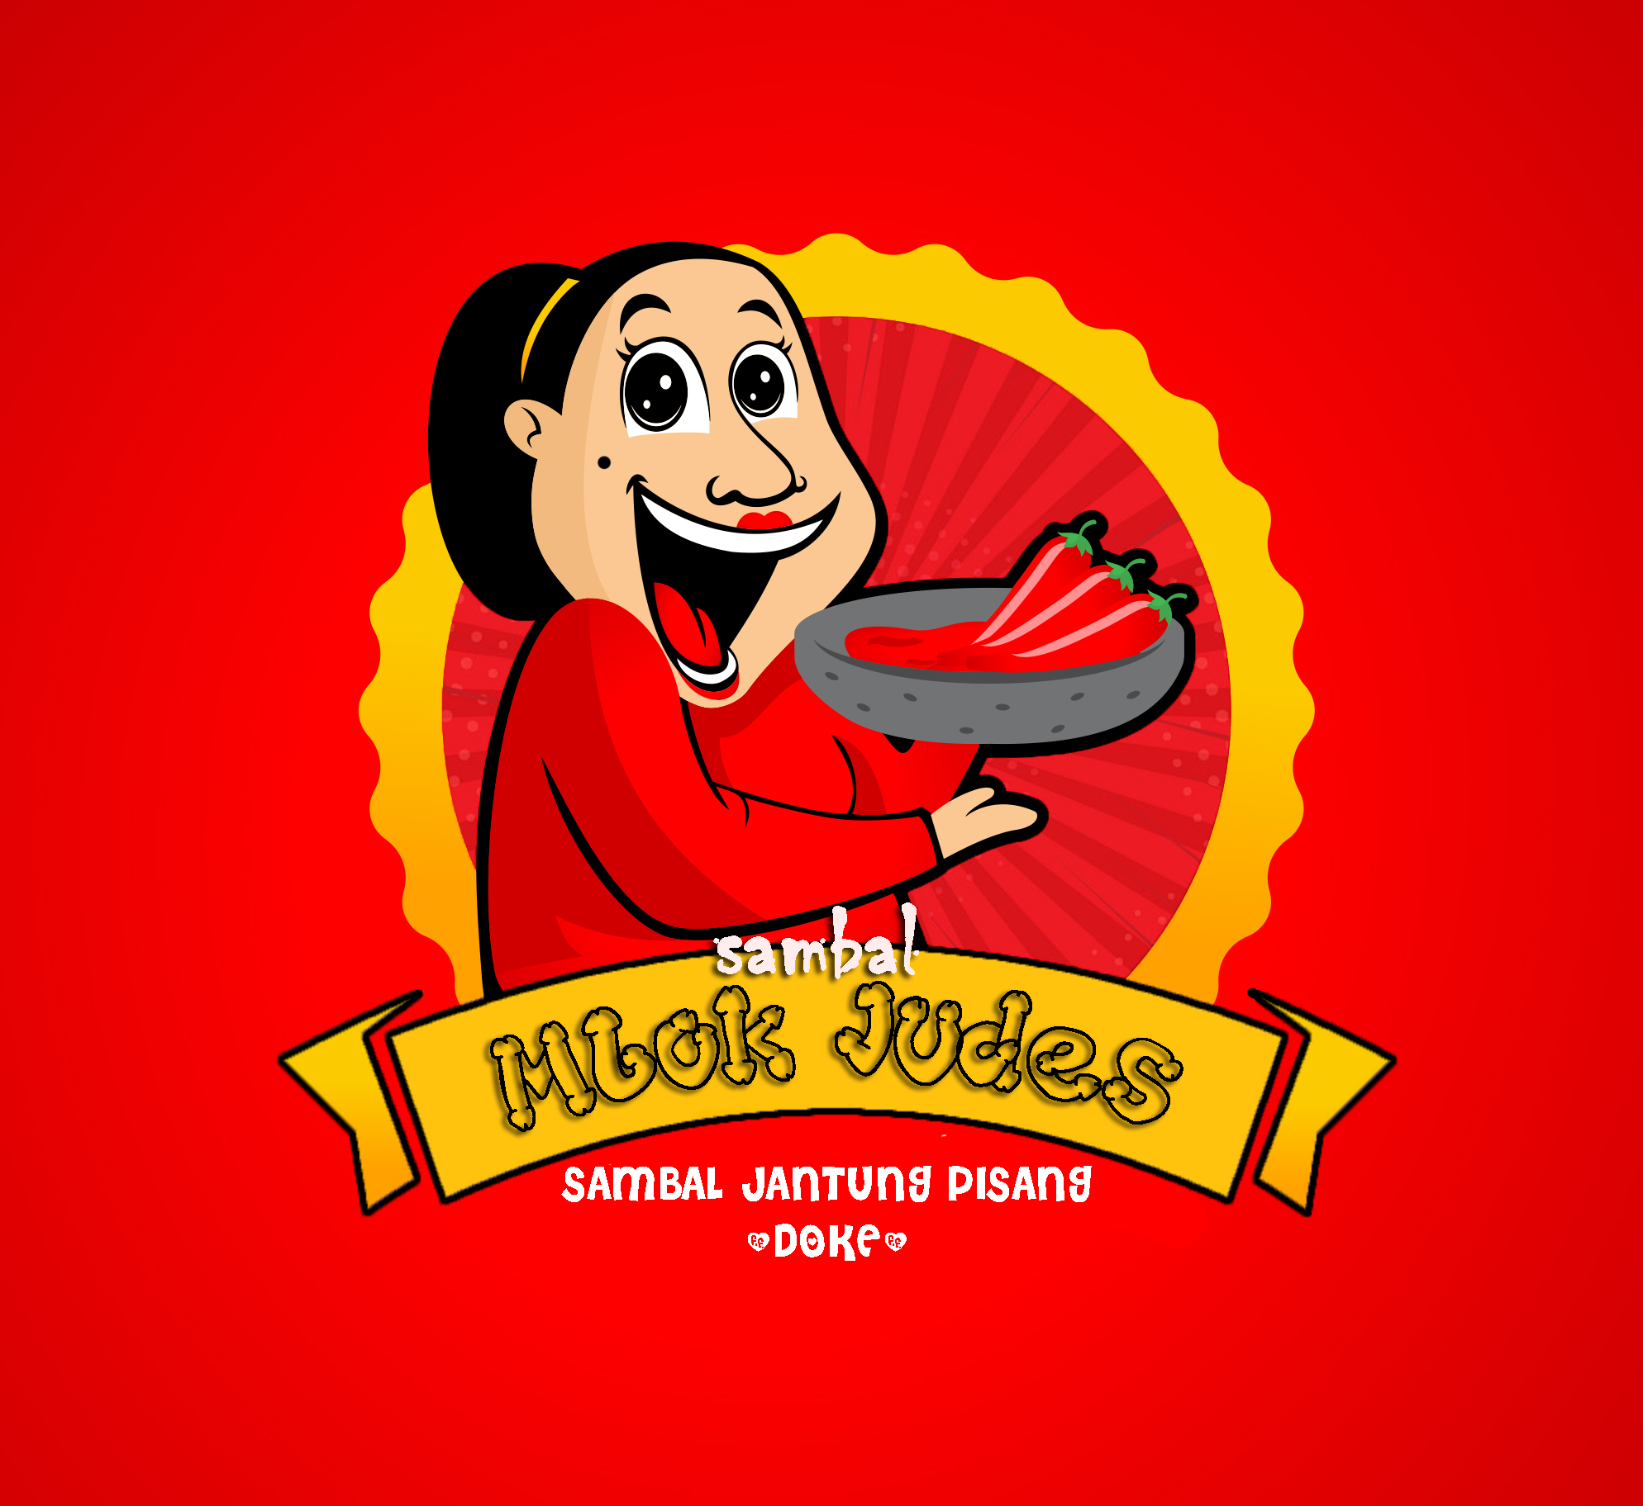
SAMBAL MBOK JUDES
COMPANY PROFILE
- TJIOE FELICIA HONORIS -

Slide 2
CV. SAMBAL MBOK JUDES
Our Office :
Jalan Jenderal Sudirman No. 3
Makassar
Sulawesi Selatan
Whatsapp : 081237372424
Instagram : sambalmbokjudes.id

Slide 3
Company History
20XX
CV Sambal Mbok Judes is a culinary company that was founded in 2020. CV Sambal Mbok Judes is well-known as a producer of various variants of sambal. Initially, this culinary business was only made as a job to fill spare time. But because of the increasing number of orders from customers, we continue to run this business. Beginning with only producing about 5 servings per day, until now producing about 80 servings per day.

Slide 4
VISION
Being the best company in the culinary field which is the first choice for consumers and introducing the taste of the authentic Indonesian foods to the world.
MISSION
• Prioritizing quality in terms of products and services.
• Develop innovations in terms of food that tastes Indonesian.
• Using quality ingredients to maintain the taste of food.

Slide 5
Business Legality
Ijin Departemen Kesehatan DIN KES PBG P IRT No. 8887564354231, 9674525478652.
P-IRT 123.8888.02.017
01
02
03
04
Sertifikat Halal No. 7362579073574, 8265384686345
Sertifikasi HACCP : 008 / MS HACCP / 2020

Slide 6
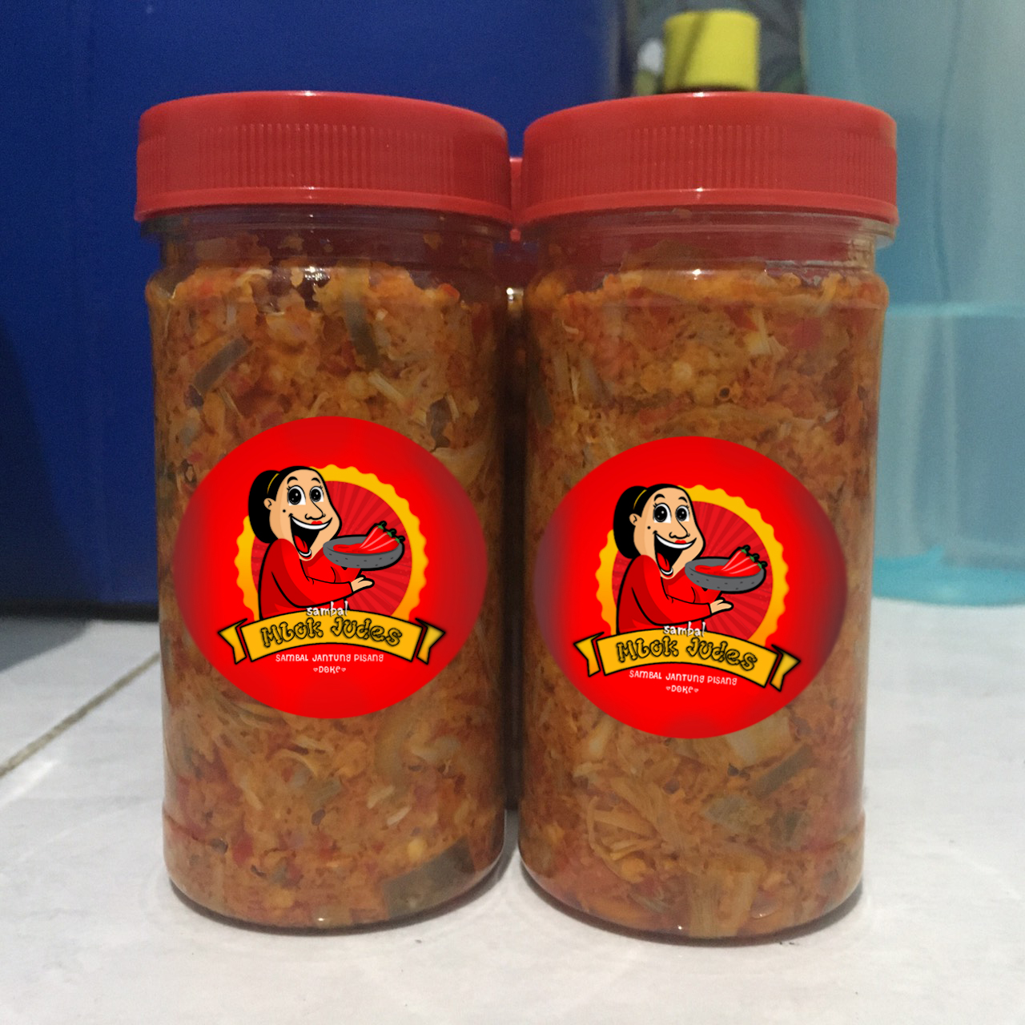
Our Product
The food that we offer is many kinds of sambal. Currently we are innovating to make a food menu that comes from ingredients that are rarely used. Therefore, we created Sambal Doke or Banana Heart Sambal where our product is the first product in Indonesia. Our new product is manifested by the desire of the owner to increase the sale value of banana heart which has many health benefits for the body.
With the selling price that relative low about 25.000/ bottle, we don't target on particular market but we hope we could sell the sambal doke that have a high standart of quality to every consumer that like to consume sambal.

Slide 7
Thank You

