Slide 1
JACKNUTS!
Jackfruit Seeds Doughnuts.
By: CV.JACKNUTS!
Instagram : @Jacknuts!sby
Surabaya, Jawa Timur
082290169020

Slide 2
About Business :
Our commitment is to bring a very common food but with a twist of new ingredients and healthy aspects.
We hope that customer will still enjoy the goodness of our doughnuts.
We hope that we can always control the quality of our product especially the seeds that we use.

Slide 3
Vission and Mission :
Vision
Make everyone know that healhty food is not always have a terible taste, and remember us for making delicious healthy food.
Mission
Use top quality on every ingredients we use.
Helping children consume healthy food that taste delicious.
Make us pioneer in creating delicious healthy food.

Slide 4
Bussiness Identity :
Name: CV. JACKNUTS!
Address : Jl.Bunggasi no.5 Kendari
Outlet : Jl.Bunggasi no.5 Kendari
Owner : Kevin Timothy
Phone : 082290169020

Slide 5
Business Legality :
Depkes PIRT no. 263547812908
Halal Certificate No.
503.7/309/11.27/PK/IX/2020
Bussines History : CV. JACKNUTS! Is a company that make doughnuts with a new and fresh ingredients which is jackfruit seeds. The product called “JACKNUTS”

Slide 6
JACKNUTS!
Jacknuts is a doughnuts made with new ingredients which is jackfruit seeds , we always maintain our seeds quality and always make a delicious doughnuts
NO PORK OR LARD
NO PRESERVATIVE

Slide 7
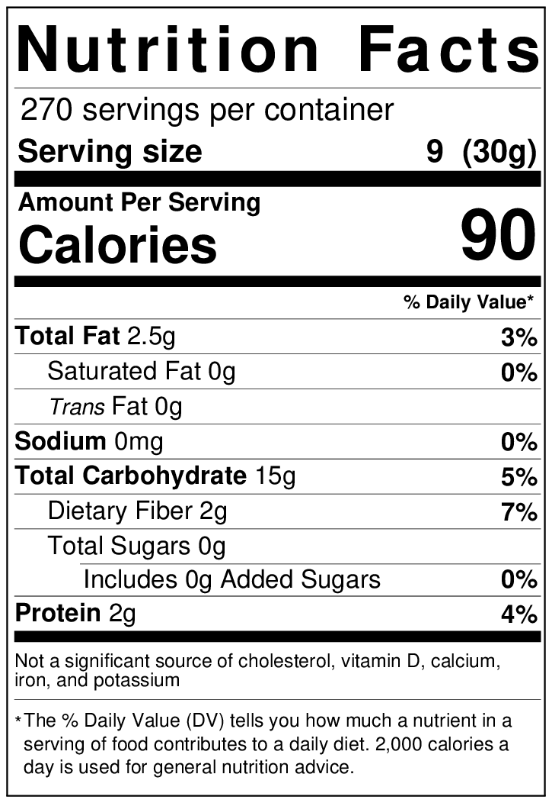
COMPOSITION & NUTRITION FACTS
Ingredients:
High protein flour : 125gr
Jackfruit seeds : 50gr
Egg yolk : 20gr
Milk : 40 ml
Margarine : 15gr
Sugar : 20gr

