Slide 1
COMPANY PROFILE
Fuse it up

Slide 2

Fuse it Up Restaurant

Slide 3
COMPANY ADDRESS
Jl. Manyar Kertoarjo, Manyar Sabrangan, Kec. Mulyorejo, Kota SBY, Jawa Timur 60116

Slide 4
HISTORY
Fuse it Up founded in 2020, we want to create a special place for fusion food from all around the world

Slide 5
CORPORATE PROFILE
We want to served a completely different food but still tasted authentic

Slide 6
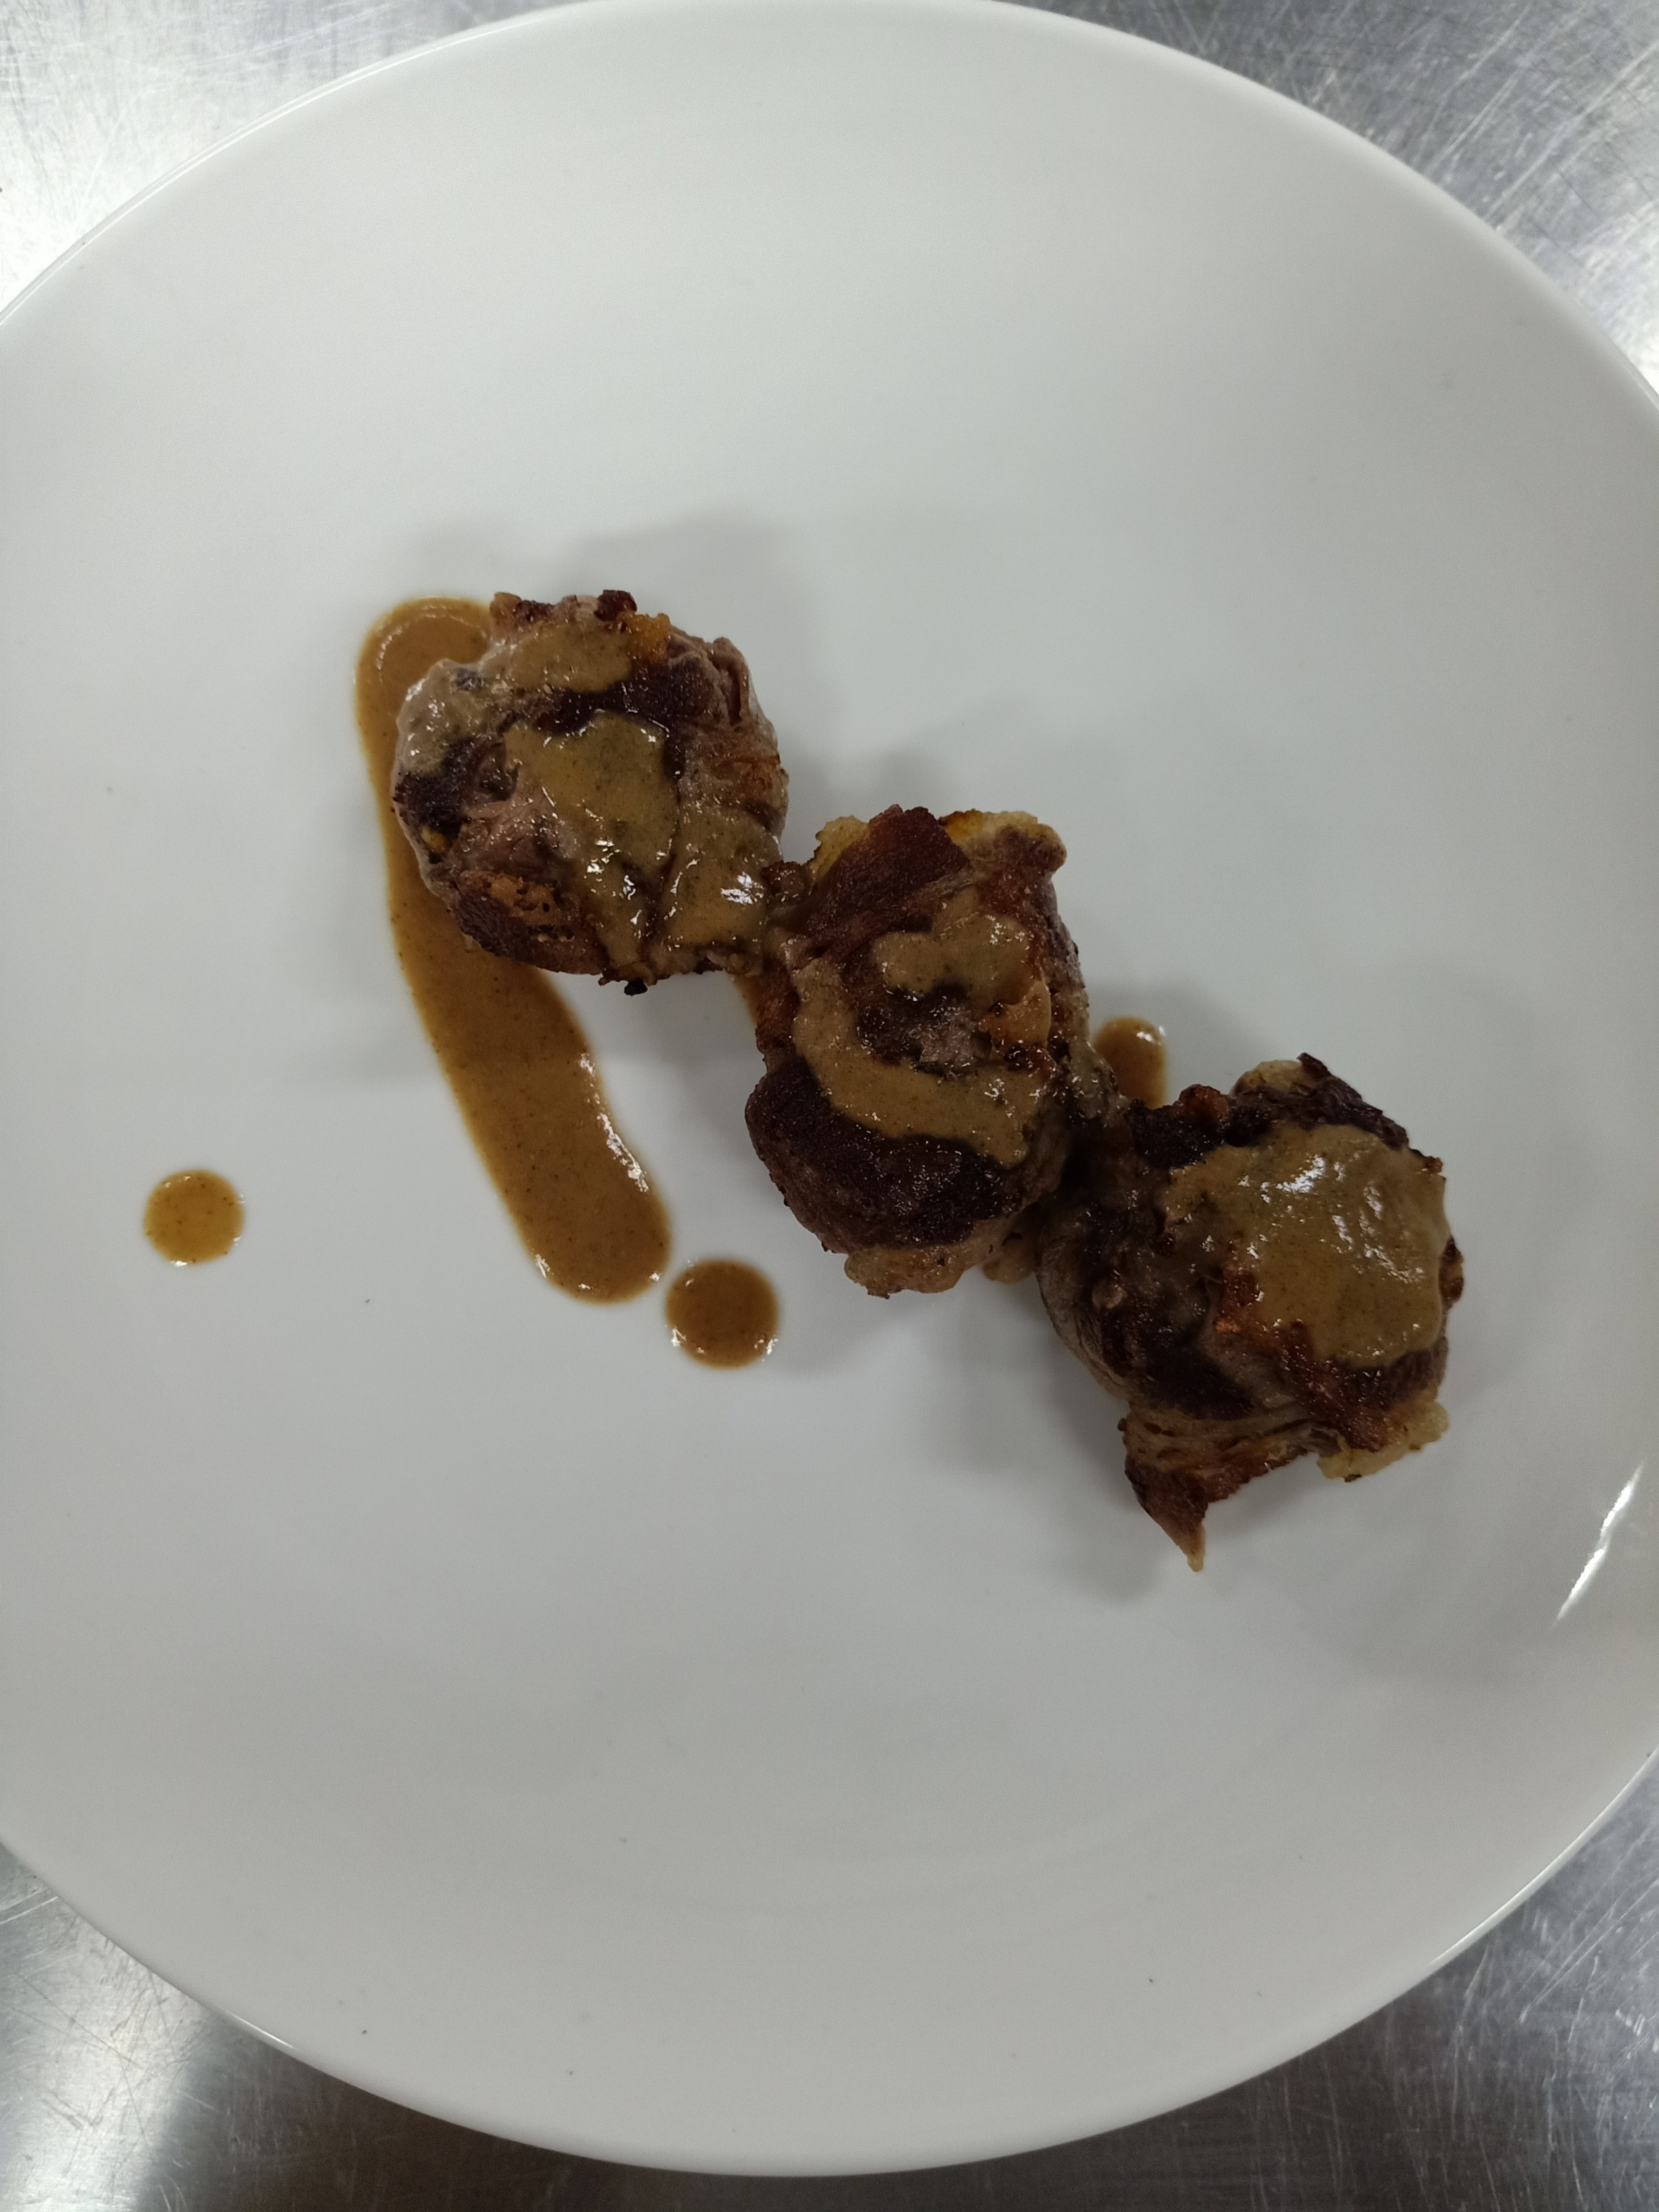
Our product example
Beef wrapped tempeh bacem

Slide 7
THANK YOU

