Slide 1
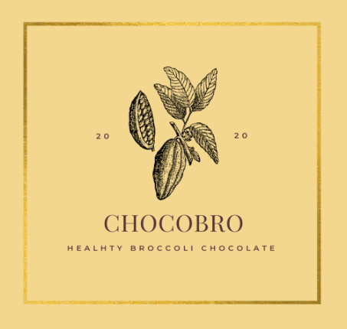
Chocobro
Chocobro healthy chocolate
BY: CV HEALTHY CCHOCOLATE
Instagram : @chocobro Surabya,Jawa Timur 082137594747

Slide 2
About Business :
Our commitment is to be a leader in culinary product and promoting people to be healthy by always creating new & innovative ideas
we also maintain our ingredients keep fresh and top quality

Slide 3
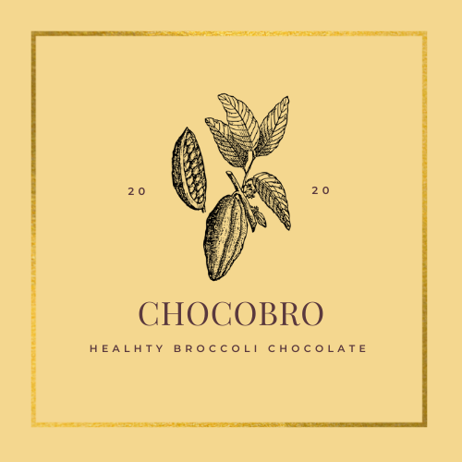
Bussiness Identity :
Name: CV. Healthy Chocolate
Address : Pawiyatan No.5 Surabaya
Outlet : Fresh Mart
Pawiyatan No.5 Surabaya
Owner : Darian Lukas
Phone : 082137594747
Business Legality :
Depkes PIRT no. 263547812908
Halal Certificate No.
503.7/309/11.27/PK/IX/2020
Vission and Mission :
Vision
Make everyone know that healhty food is not always have a terible taste, and remember us for making delicious healthy food.
Mission
Use top quality on every ingredients we use.
Helping children consume healthy food that taste delicious.
Make us pioneer in creating delicious healthy food.
Bussines History :
CV. Healthy Chocolate established in 2020, with our product, “CHOCOBRO”. A new creation of healthy chocolate combine with broccolli puree.

Slide 4
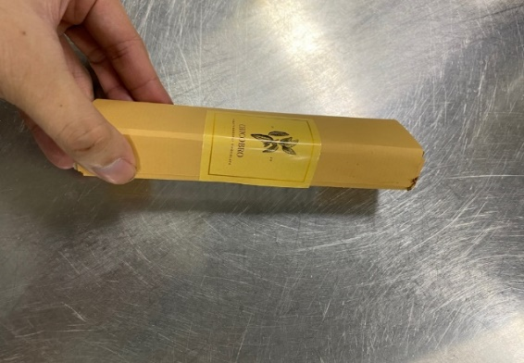
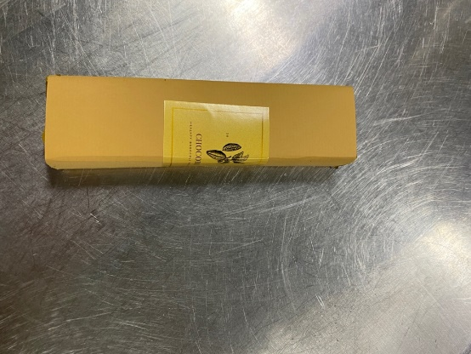
CV. Healthy Chocolate 2020
CV. Healhty Chocolate is a company engaged in culinary products, especially in healhty snack. One of our inventions is Chocobro healthy chocolate. Chocobro is a healthy chocolate made from pure dark chocolate and organic broccoli puree.
This is how we package our chocolate and ready to deliver to your home.

Slide 5
Chocobro
Chocolate bar combine with broccoli puree to add more nutriens and vitamin but also make delicious flavors.
NO PRESERVATIVE.
NO PORK OR LARDS.

Slide 6
COMPOSITION & NUTRITION FACTS
Ingredients :
Broccoli 250gr
Gelatin 10gr
Sugar 100gr
Dark chocolate 350gr
Citric acid 5gr

Slide 7
THANKYOU

