Slide 1
Snach Company Profile
Daniel Putra Soegiono

Slide 2
Table of Content
1. History
2. Product,Vision and Mission
3. Founder
4. Contact

Slide 3
History
Green Salt by snach is a salt derived from spinach containing all of its nutritional value within the spinach.

Slide 4
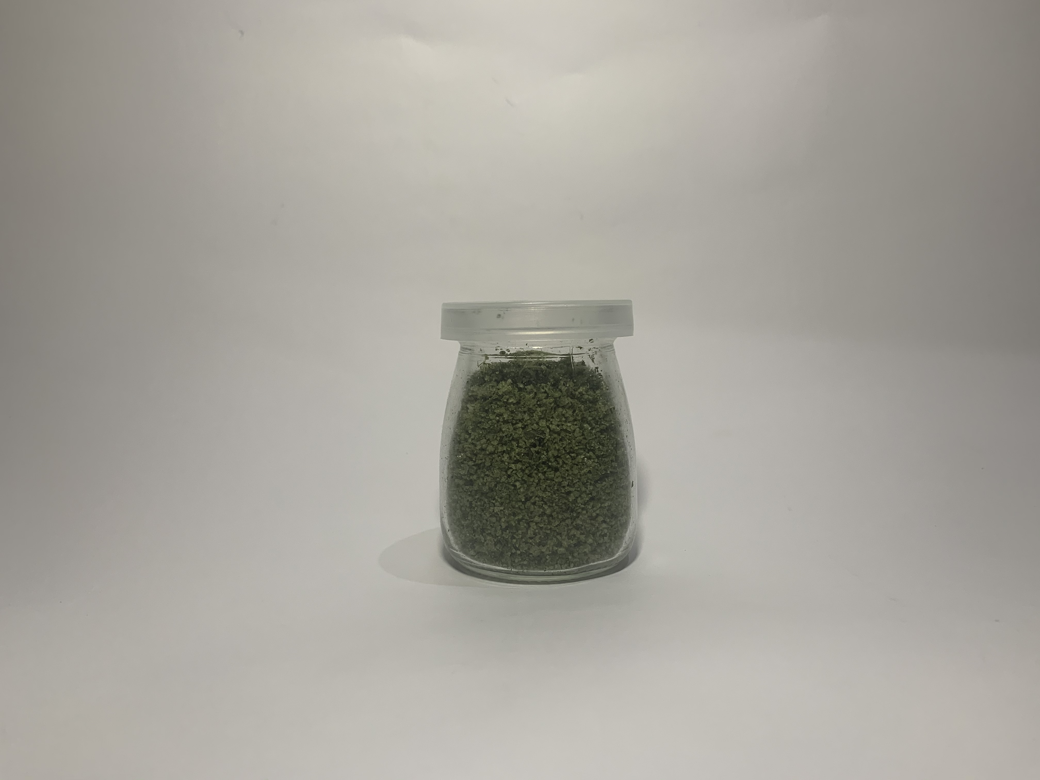
Product

Slide 5
Price
Rp. 45.000

Slide 6
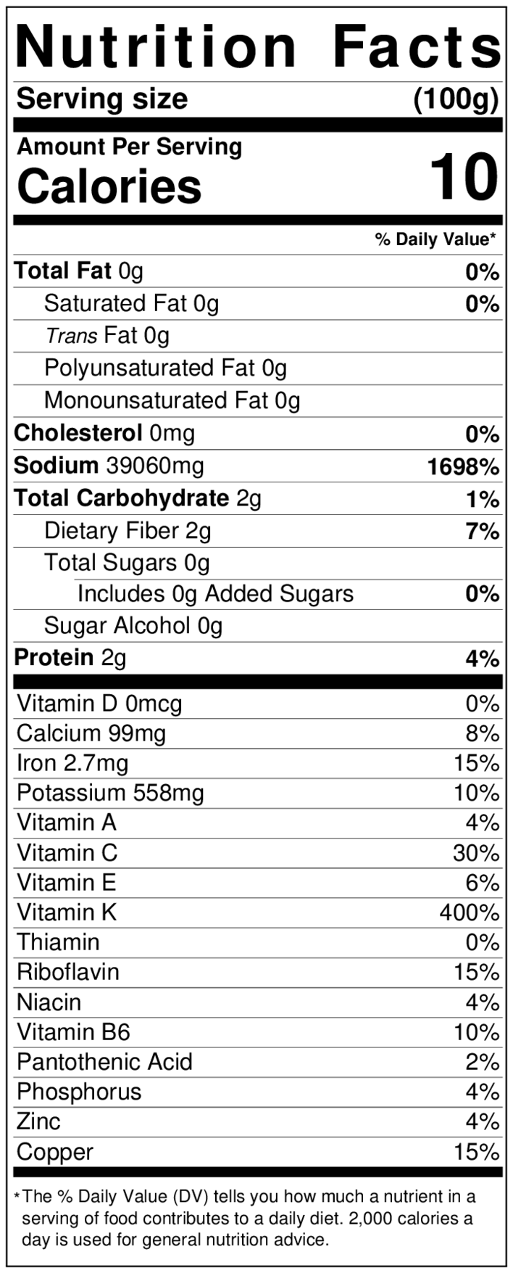
Nutritional Facts

Slide 7
Vision and Mission
Vision: To create a healthy life amongst the society and in order to achieve that we create green salt in order to prevent diseases by consuming green salt, we are boosting our immune system.
Mission: To achieve our vision, we can:
Create a campaign or talk show about healthy lifestyle
Make our customers happy and satisfied about our product
Educate people about being healthy.

Slide 8

Founder
Daniel Putra
Soegiono

Slide 9
Contact
+62 81358437199

