Slide 1
ACARASA (MOLECULAR GASTRONOMY TECHNIQUE FOR MAKING PICKLES)
By : CV.ACARASA Surabaya, Jawa Timur
Instagram : Acarasa.idn
Phone number: 082232662347

Slide 2
ABOUT BUSINESS
Introduced a gastronomy molecular technique to the general public
Create Pickles with different textures
Make customers feel a different and unique sensation when enjoying pickles
For internship requirements

Slide 3
VISION AND MISSION
Vision :
So that customers can feel a different sensation when enjoying food. Acarasa will be the first company to pioneered uniqueness in the field of culinary
Mission :
Always provide the best quality for customers
Always creating new innovations in the culinary field
Will always satisfy customers with our products

Slide 4
BUSSINES IDENTIFY
NAME : ACARASA
ADRESS : JL. Taman Gapura E6/5
OUTLET : JL. Dr Wahidin No 102 KEDIRI
OWNER : Cornelius Yurian Afila
PHONE NUMBER : 082232662347

Slide 5
LEGALITY
Business Legality :
Depkes PIRT no. 263547812908
Halal Certificate No. :
503.7/309/11.27/PK/IX/2020
Bussines History : CV. ACARASA Is a company that make pickles with a new thecnique. The product called “ACARASA”

Slide 6
ACARASA
Acarasa is a new invention in pickles
Unique thechnique for making pickles
New innovation in culinary industry

Slide 7
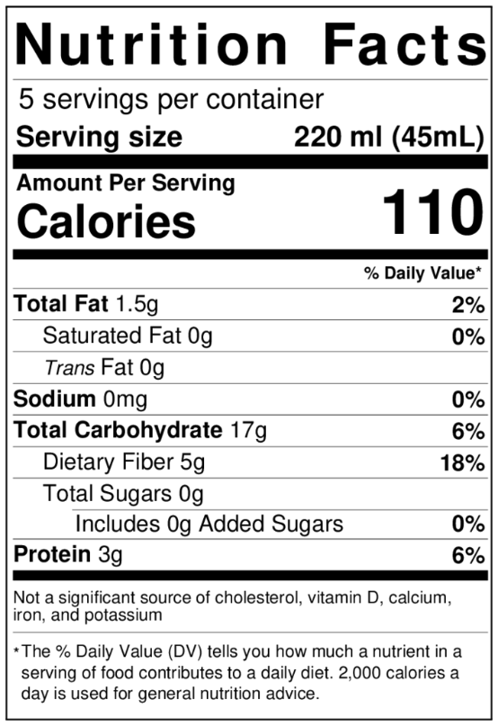
NUTRITION FACTS
No | Ingredient Description | Total Unit (per day)
1. | Sodium alginate | 15g
2. | Calcium lactate | 24g
3. | Demineral water | 3ltr
4. | Vinegar | 135ml
5. | Cucumber | 2,1kg
6. | Shallots | 120g
7. | Pineapple | 1050g
8. | Chili | 300g
9. | Sugar | 150g
10. | Salt | 50g

