Slide 1
Company profile
CV NUSANTARA TASTE

Slide 2
CV NUSANTARA TASTE
HEALTHY TOFU WITH MANADO FLAVOR

Slide 3
ADDRESS COMPANY
JL. WINANGUN SATU NO 33 MANADO, NORTH SULAWESI UTARA
TLP. (043) 1620907

Slide 4
HISTORY
NUSANTARA TASTE was founded in 2020.
We are hope that Woku Tofu can help people to have healthy food with rich benefits and good flavor.

Slide 5
CORPORATE PROFILE
{ We Always Served Innovate Healthy Foods with Nusantara Taste }

Slide 6
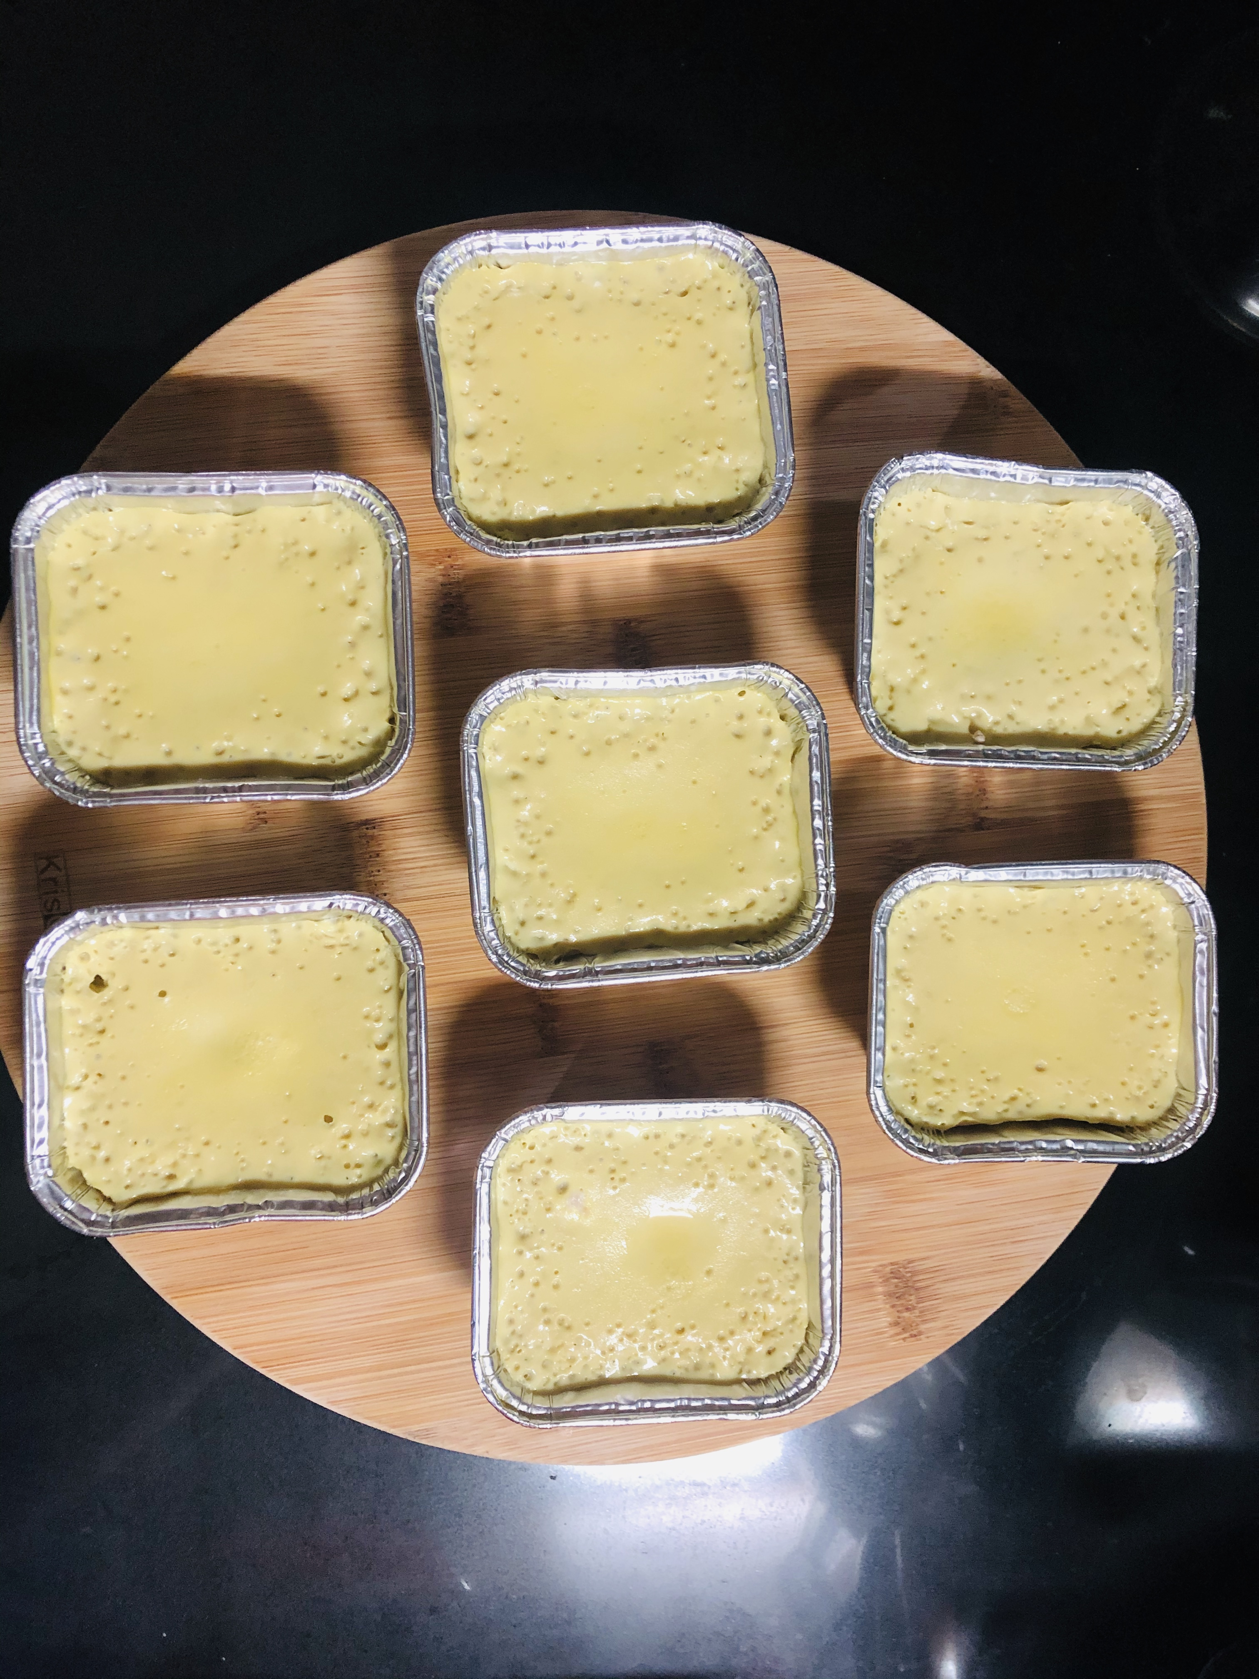
PRODUCT
WOKU TOFU

Slide 7
CLIENT LIST
NO | NAME | ADDRESS | INFO
1 | PT JUMBO PASAR SWALAYAN MANADO | Jl. Suprapto No.1, Wenang Utara | ACTIVE
2 | PT GOLDEN PASAR SWALAYAN MANADO | Jl. Piere Tendean, Wenang Utara | ACTIVE
3 | PT GELAEL SUPERMARKET MANADO | Jl. Jend Sudirman No.92, Paal Dua, Wenang, Pinaesaan | ACTIVE

Slide 8
THANK YOU

